Slide 1
MedIA Group
Introduction
Architecture
Training
Test
Evaluation
Future Work
References
Skeletal Muscle Cell Segmentation Using Distributed Convolutional Neural Network
Fuyong Xing, Manish Sapkota, Fujun Liu
Medical Image Analysis (MedIA) Group
Proposal for Big Data,
March 11, 2015

Slide 2
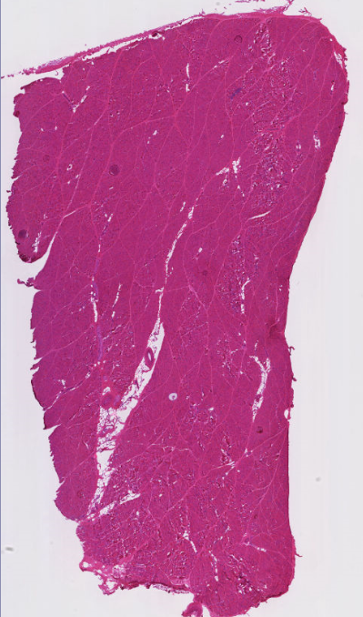
MedIA Group
Introduction
Architecture
Training
Test
Evaluation
Future Work
References
Background
There is agreement across the muscle biology community that muscle fiber area, are critical factors that determine the health of the muscle.
However, at this time, quantification is still a manual or, at best, a semi-automatic process. This process is labor intensive and time consuming and can be prone to errors, leading to high inter-observer variability.

Slide 3
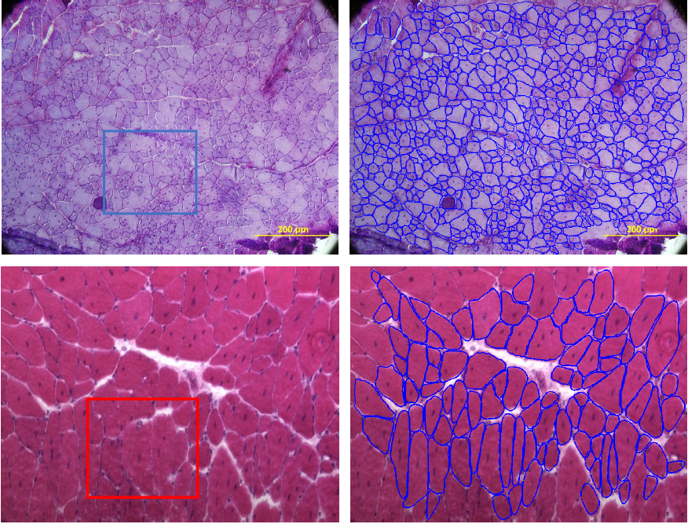
MedIA Group
Introduction
Architecture
Training
Test
Evaluation
Future Work
References
Challenges

Slide 4
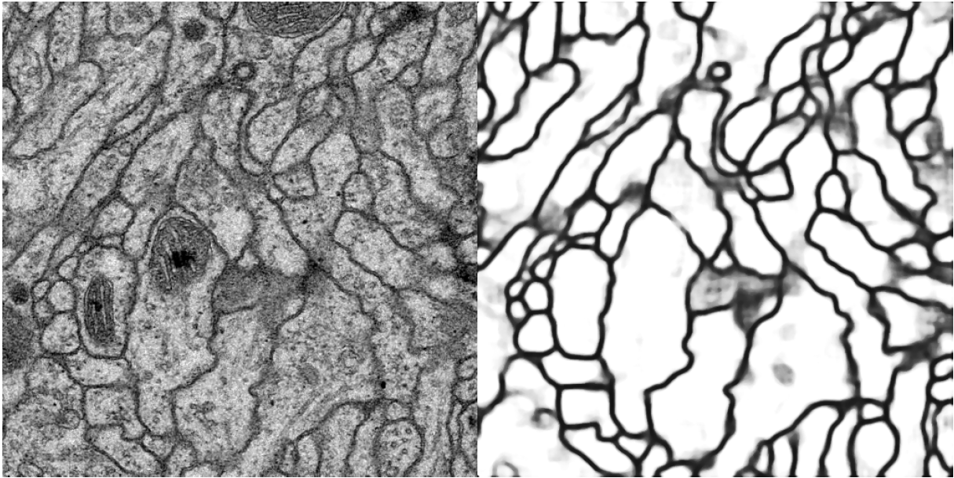
MedIA Group
Introduction
Architecture
Training
Test
Evaluation
Future Work
References
Related Work
Ciresan, Dan, et al. "Deep neural networks segment neuronal membranes in electron microscopy images." Advances in neural information processing systems. 2012.

Slide 5
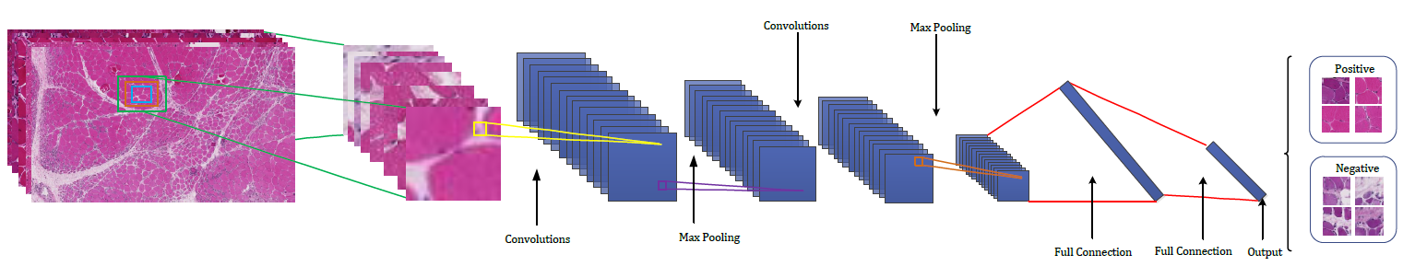
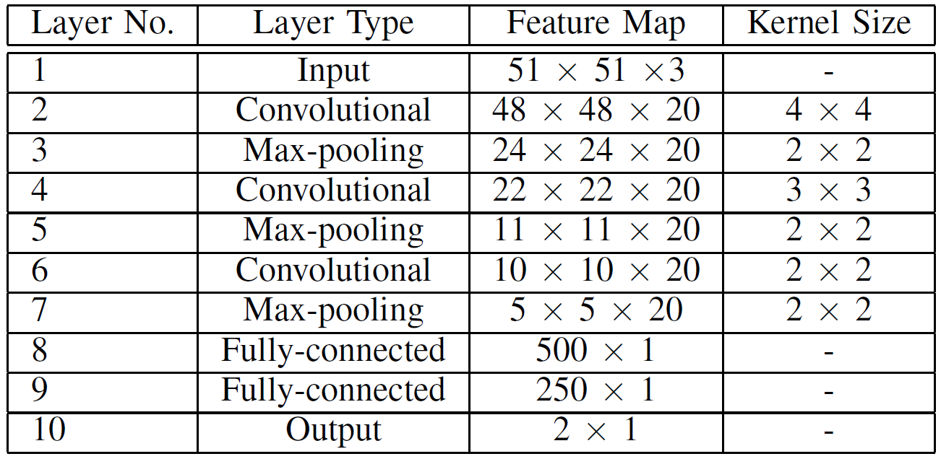
MedIA Group
Introduction
Architecture
Training
Test
Evaluation
Future Work
References
Deep Convolutional Neural Network (CNN) for Muscle Segmentation

Slide 6

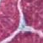
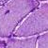
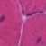

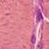
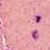
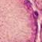

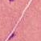
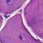
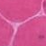
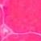



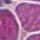

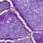







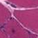
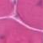
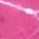

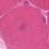



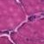
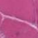
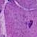
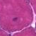

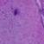
MedIA Group
Introduction
Architecture
Training
Test
Evaluation
Future Work
References
Training Images
Positive
Negative
In total, two million samples are used for training

Slide 7
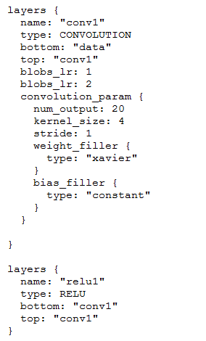
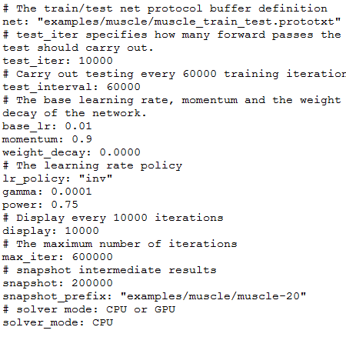
MedIA Group
Introduction
Architecture
Training
Test
Evaluation
Future Work
References
Training
Define solver file
Define model file
Caffe: http://caffe.berkeleyvision.org/

Slide 8
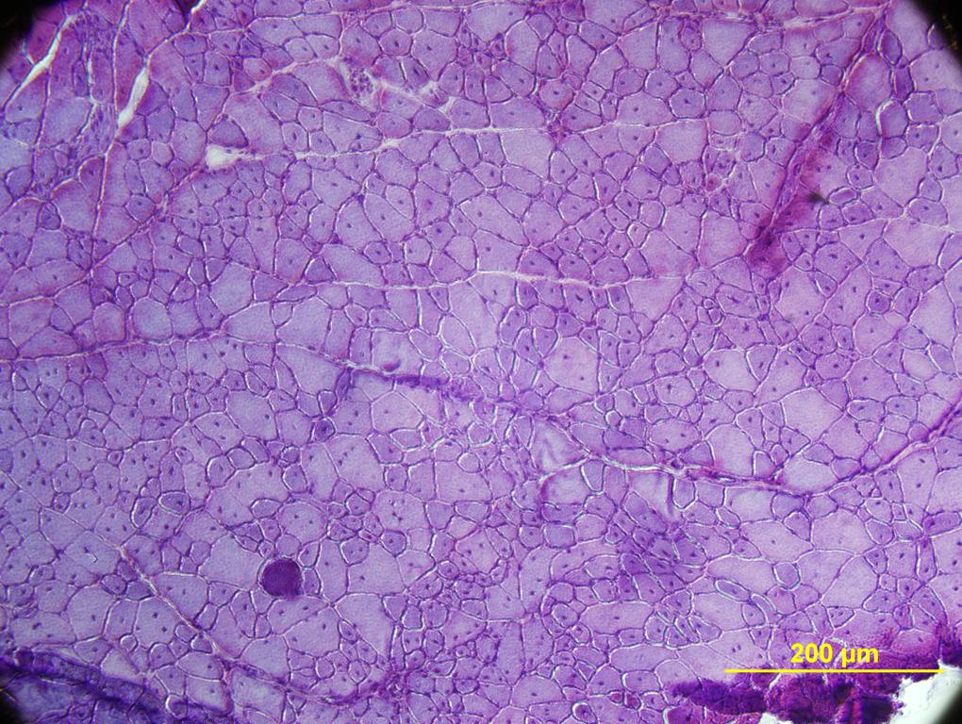
MedIA Group
Introduction
Architecture
Training
Test
Evaluation
Future Work
References
Test
Training
Test
Sliding window is a straightforward solution

Slide 9
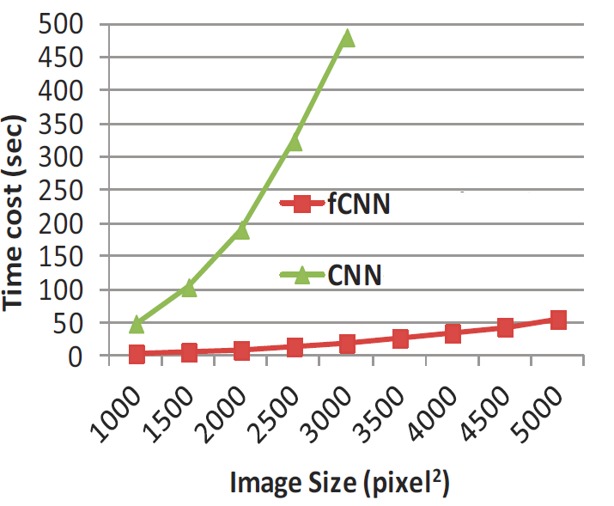
MedIA Group
Introduction
Architecture
Training
Test
Evaluation
Future Work
References
Sliding window DOES NOT SCALE

Slide 10
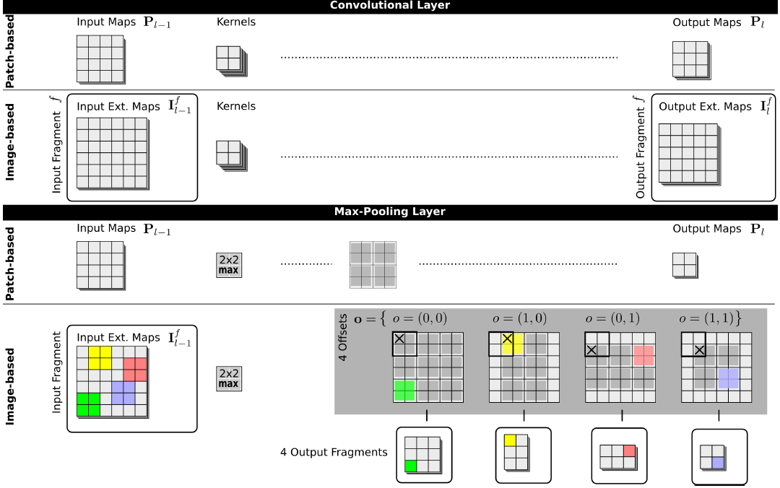
MedIA Group
Introduction
Architecture
Training
Test
Evaluation
Future Work
References
Fast Scanning

Slide 11
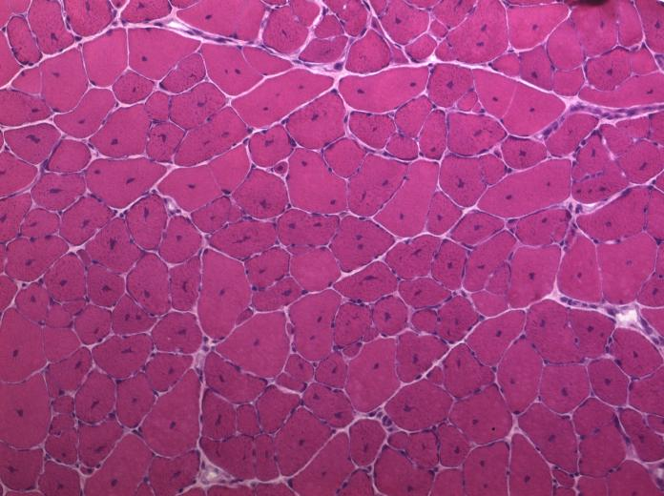
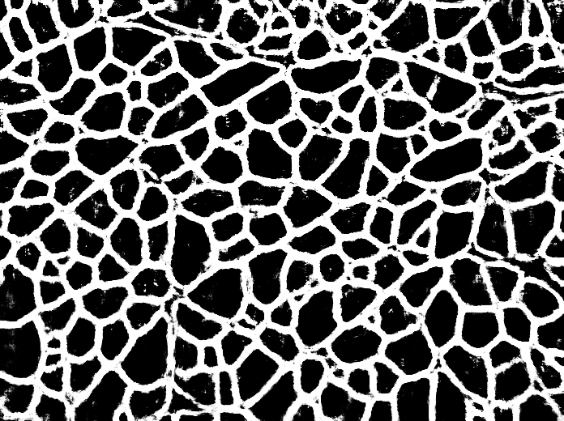
MedIA Group
Introduction
Architecture
Training
Test
Evaluation
Future Work
References
Fast Scanning

Slide 12
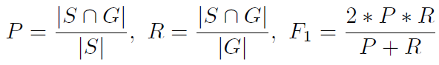
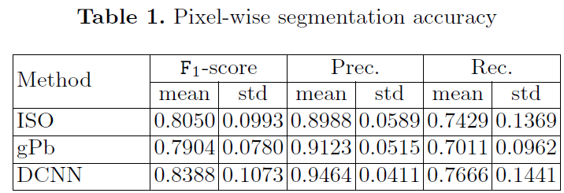
MedIA Group
Introduction
Architecture
Training
Test
Evaluation
Future Work
References
Evaluation
Metric: precision (P), recall (R) and F1 score

Slide 13
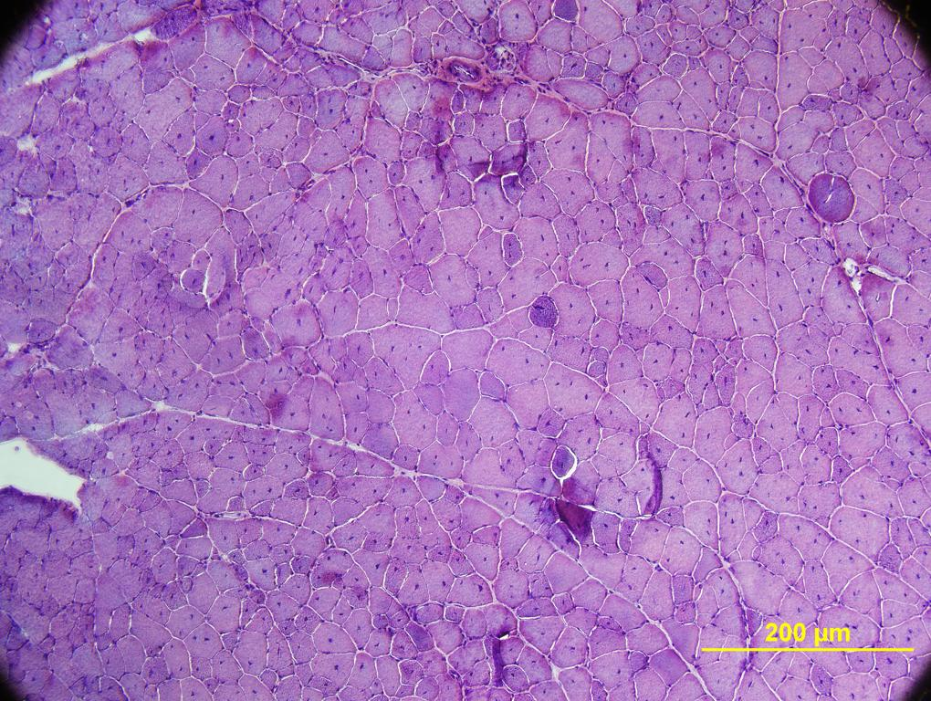
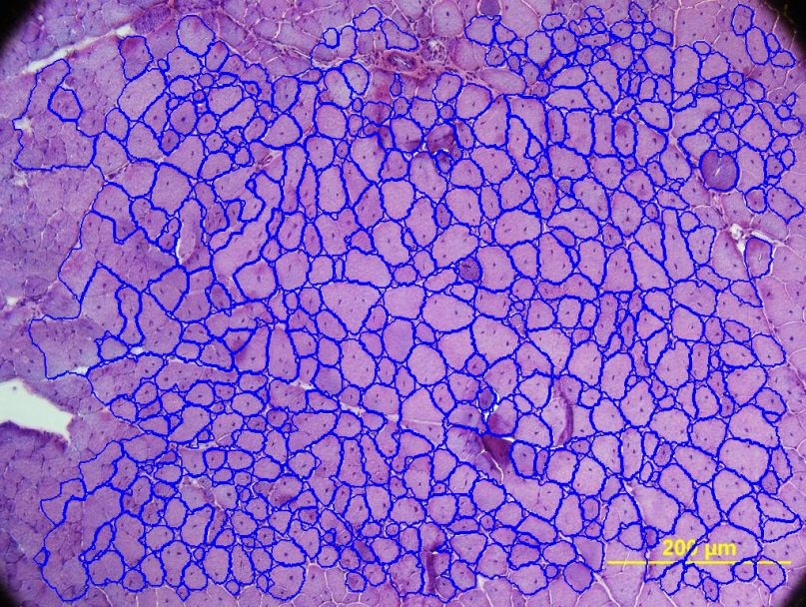
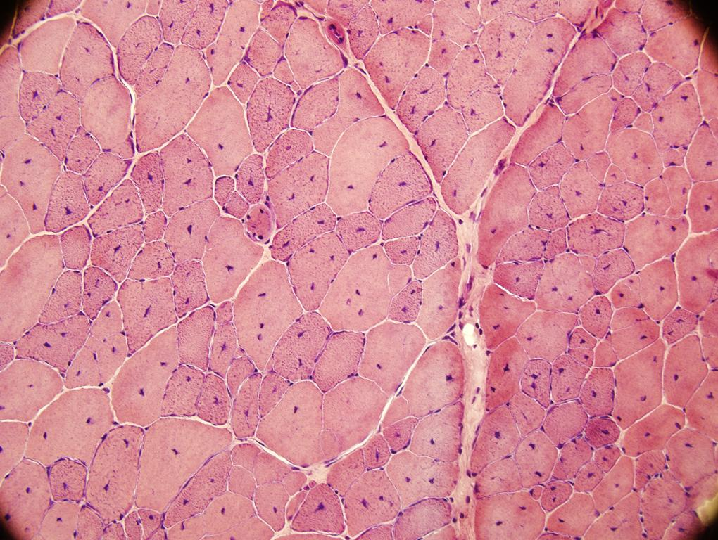
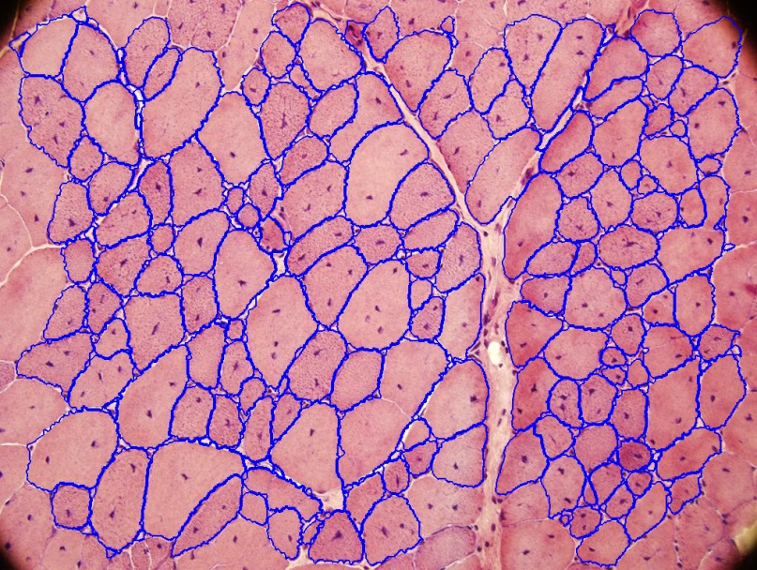
MedIA Group
Introduction
Architecture
Training
Test
Evaluation
Future Work
References
Sample Results

Slide 14
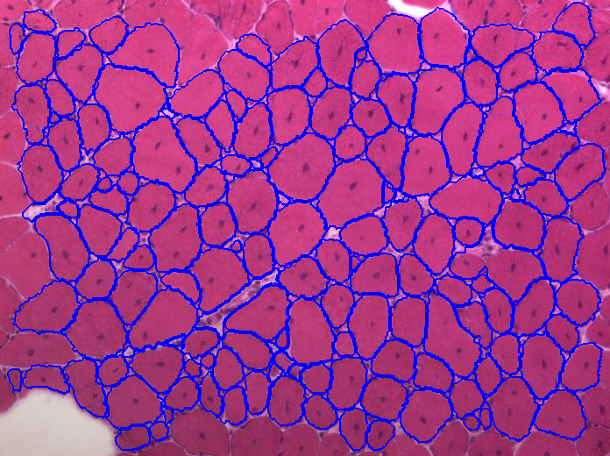
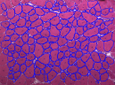
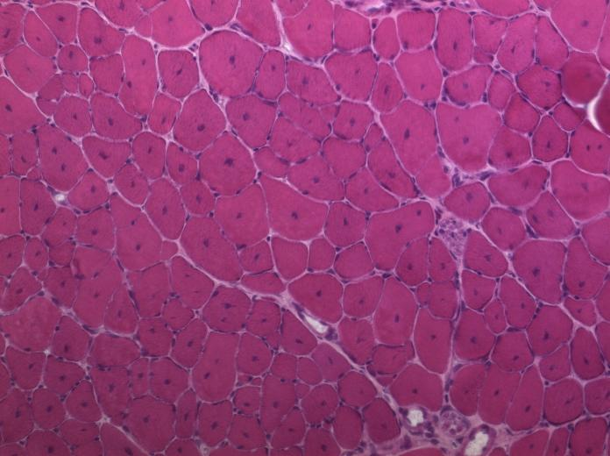
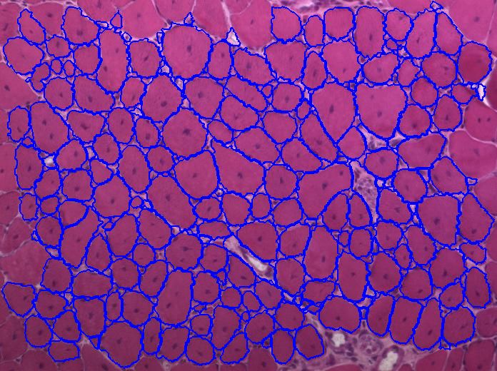
MedIA Group
Introduction
Architecture
Training
Test
Evaluation
Future Work
References

Slide 15
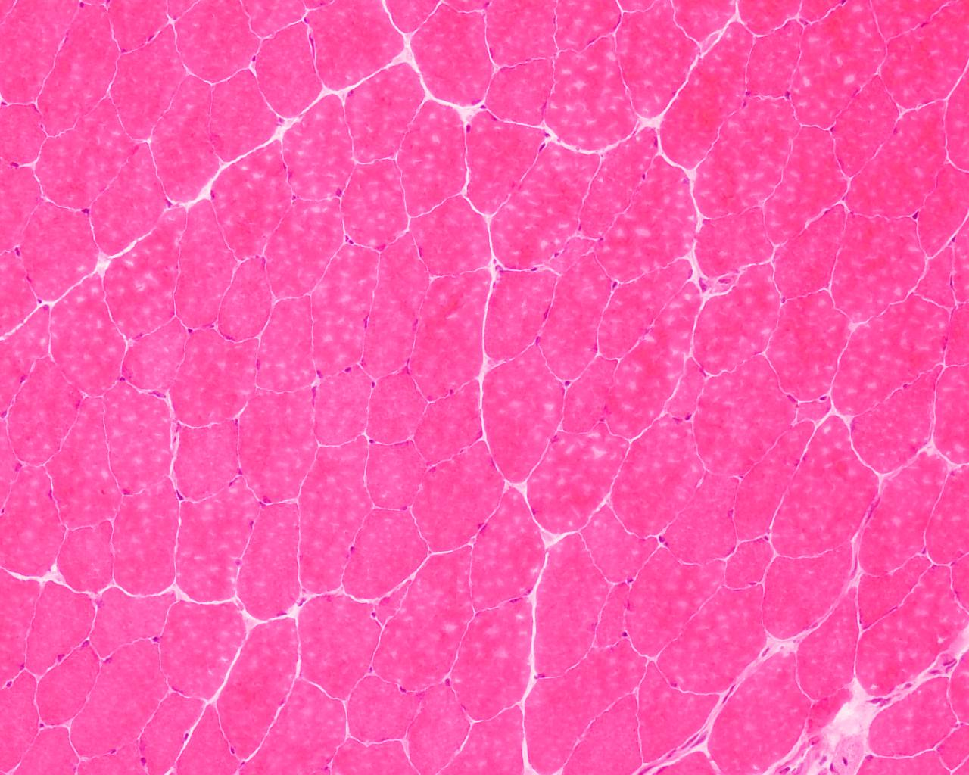
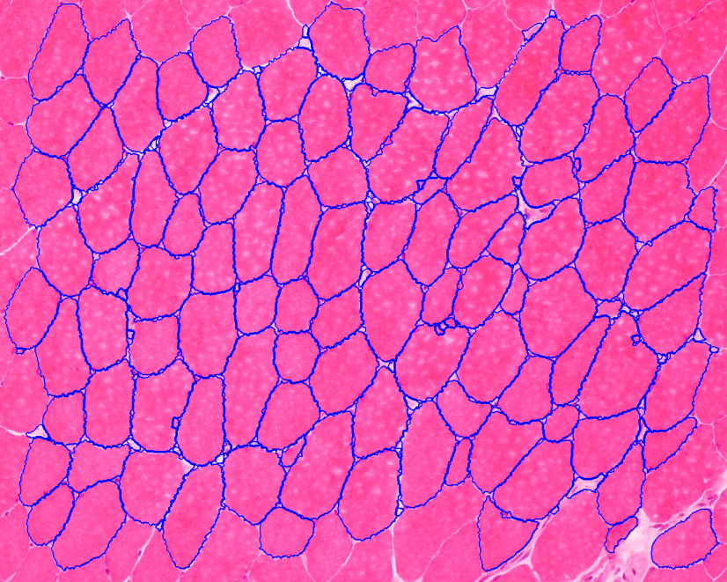
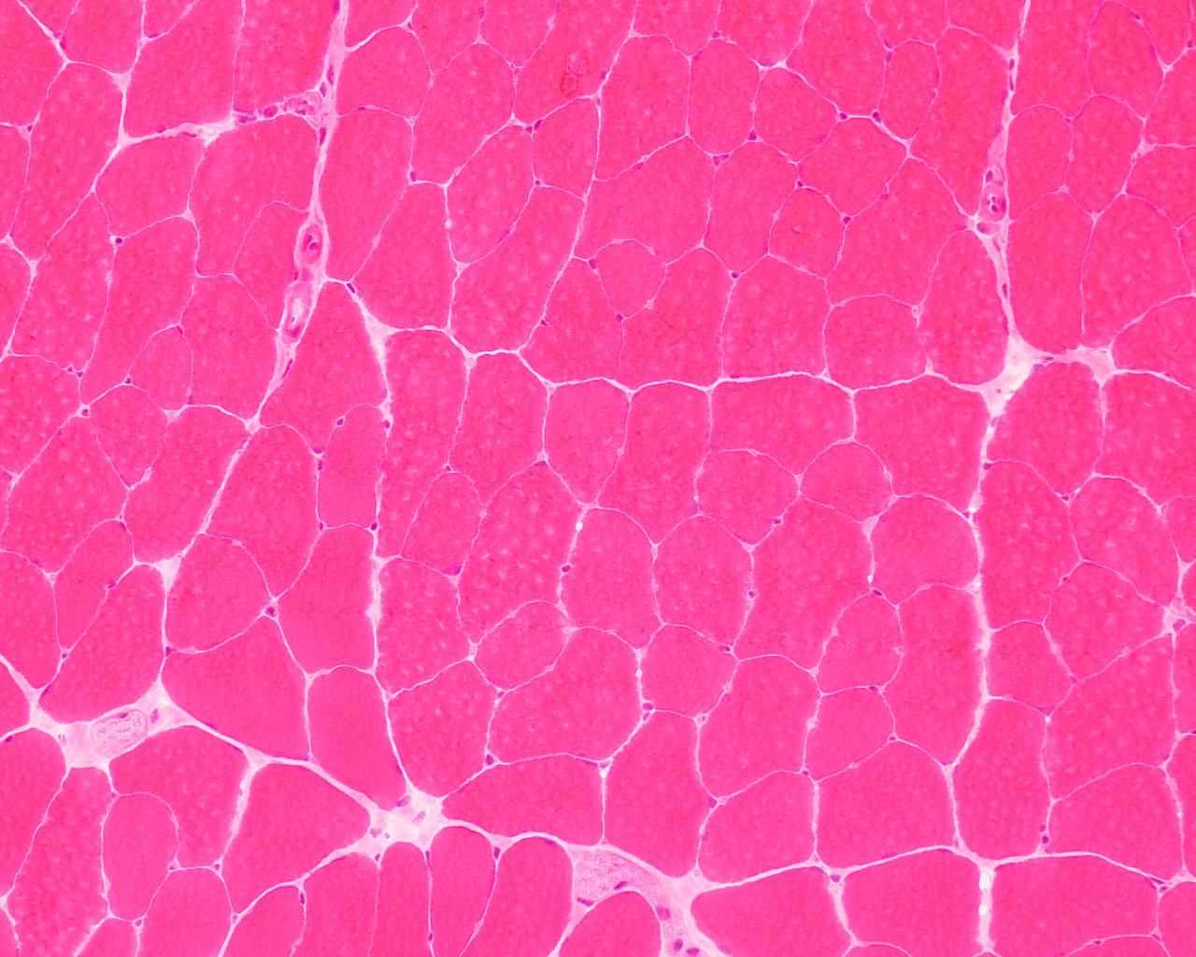
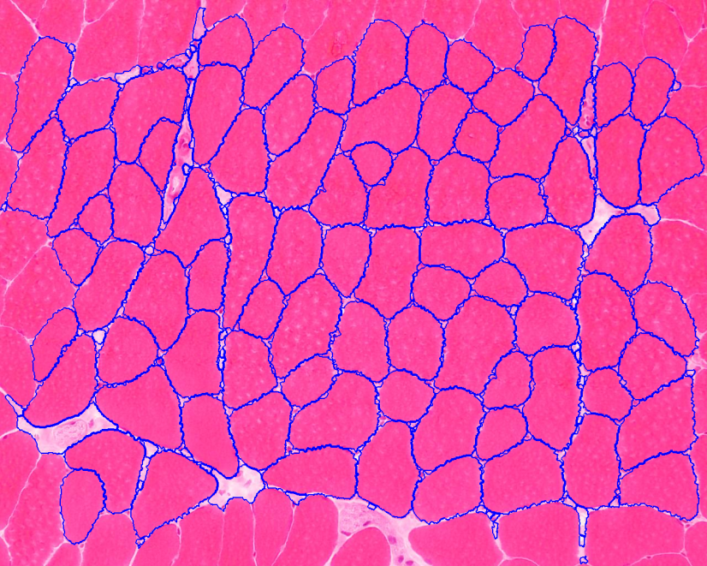
MedIA Group
Introduction
Architecture
Training
Test
Evaluation
Future Work
References

Slide 16
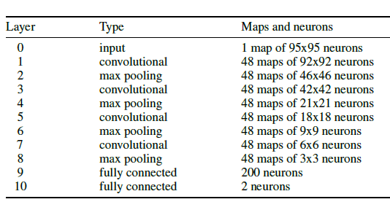
MedIA Group
Introduction
Architecture
Training
Test
Evaluation
Future Work
References
A larger model
Model we used
Model used in [2]
However, a larger model means longer time to train.

Slide 17
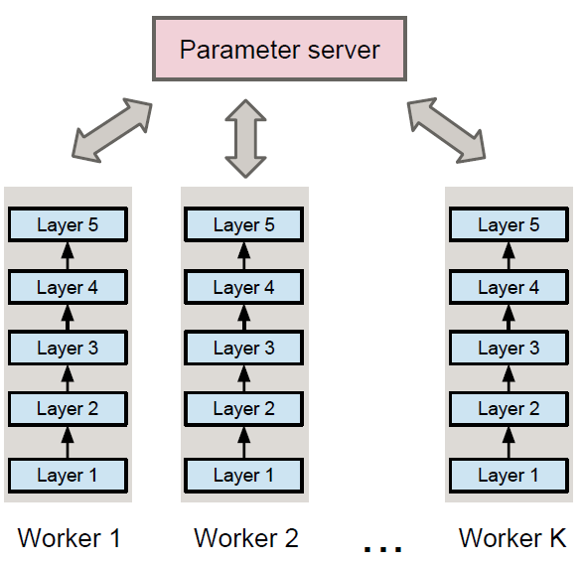
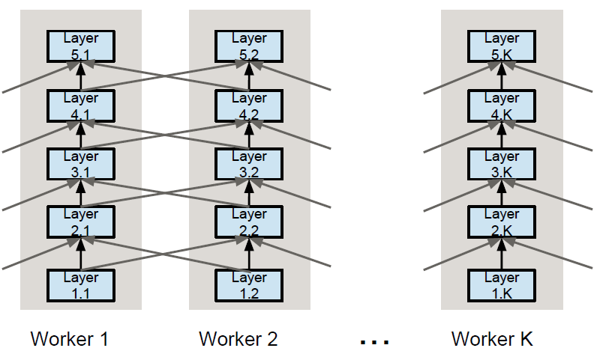
MedIA Group
Introduction
Architecture
Training
Test
Evaluation
Future Work
References
Distributed deep network
Data parallelism
Model parallelism
Figure courtesy of Alex Krizhevsky

Slide 18

MedIA Group
Introduction
Architecture
Training
Test
Evaluation
Future Work
References
Parallelism for CNN
Figure courtesy of Alex Krizhevsky

Slide 19

MedIA Group
Introduction
Architecture
Training
Test
Evaluation
Future Work
References
Whole slide
A whole slide image
A small image sample with size 689 x 1354
Currently only a small number of image patches are sampled from a whole slide
Cloud computing might be the only solution for whole slide image processing

Slide 20
MedIA Group
Introduction
Architecture
Training
Test
Evaluation
Future Work
References
References
[1] Giusti A, Cireşan D C, Masci J, et al. Fast image scanning with deep max-pooling
convolutional neural networks. arXiv preprint arXiv:1302.1700, 2013.
[2] Ciresan D, Giusti A, Gambardella L M, et al. Deep neural networks segment neuronal membranes in electron microscopy images, Advances in neural information processing systems. 2012: 2843-2851.

